Slide 1

UNIT-II Entrepreneurial Business Selection and Entrepreneurial Finance
Entrepreneurship and Project Management

Slide 2
Entrepreneurial business selection and Entrepreneurial Finance
Entrepreneurial Business Selection
Entrepreneurial Finance
Criteria for selection of Business Structure
Types of Business Structures
Sole Proprietorship
Partnership - Limited Liability Partnership
One-person company
Joint stock company – Features - Merits & Demerits
Factors affecting Fixed Capital and Working Capital requirements
Sources of raising Finance
Financial Institutions in India.

Slide 3
Business Activities
Business Activities are classified into two
Industry
Commerce
Business = Industry + Commerce
↓ ↓ ↓
Production&Distribution = Production + Distribution ↓ ↓
Trade + Aids to Trade
Commerce =Exchange of Goods and Services

Slide 4
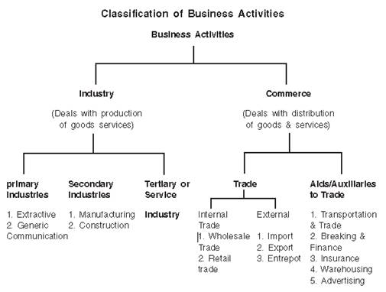
Classification of Business Activities

Slide 5
Business – Definition & Characteristics
According to Wheeler, ”A Business undertaking is a concern, company or one person or a group of persons and is managed under a specific set of operating policies”
Characteristics of a Business unit
Exchange of goods and services ( Produced or procured from other services)
Dealing in goods and services(Consumers goods or Producers goods)
Profit Motive
Continuity of Transactions
Risk and uncertainty – Fire, earthquake, Strikes influenced by future events as future is uncertain
Social Responsibility ( Cheaper and better quality goods) (Schools, Hospitals avoid water and air pollution)

Slide 6
Criteria for selection of Business Structure
Nature of Business
Area of operations
Degree of Control
Capital Requirements
Extent of Risk and Liability
Duration of Business
Government Regulations

Slide 7
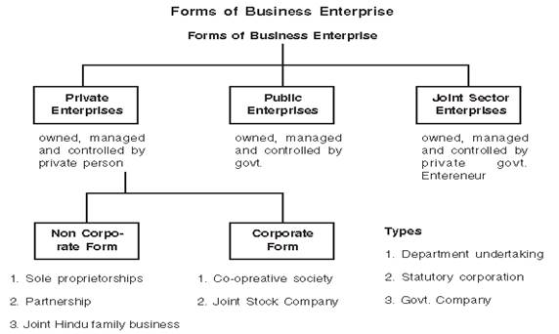
Types of Business Structures

Slide 8
Forms of Business undertakings
Private Undertakings
Public undertakings
Joint Sector Undertakings
Sole proprietorship
Partnership
Joint Hindu Family business
Joint Stock company
Cooperative Societies
Departmental Organisations
Public corporations
Government Companies
Joint Sector Undertakings

Slide 9

Sole Proprietorship
Single Entrepreneurship, Sole Trader, Individual Proprietorship
”A Sole Trader is a person who carries on business exclusively by and for himself. He is not only the owner of the capital undertaking, but usually the organiser and manager and takes all profits or responsibility for losses”
James Stephenson

Slide 10
Sole Proprietorship - Characteristics
Individual Initiative
Unlimited Liability
Management control
Motivation
Secrecy
Proprietors and Proprietorship are one and the same
Owners and business exist together
Limited area of operations

Slide 11
Sole Proprietorship -Advantages
Easy in Formation
Better control
Flexibility in operation
Retention of Business Secrets
Easy to raise finance
Direct motivation
Direct accessibility to consumers
Inexpensive management
No legal restrictions
Socially desirable:Large numbers of sole traders have entered all types of business. It helps in avoiding concentration of wealth. Large scale business leads to wealth accumulation in few hands. Sole trade business also provides competition to other businesses.
Self-employment
Healthy relations with employees
Benefits of Inherited goodwill

Slide 12
Sole Proprietorship -Disadvantages
Limited resources
Limited managerial ability
Unlimited liability
Uncertain continuity
Limited scope of employees
No large scale economies
More risk involved

Slide 13
Sole Proprietorship - Suitability
When Market is Local
When personal contact with customer is required
Speculative business

Slide 14
Partnership
The inherent disadvantage of the Sole proprietorship in financing and managing an expanding business paved the way for partnership as a viable option. Partnership serves as an answer to the needs of greater capital investment, varied skills and sharing of risks.
Section 4 of the Indian Partnership Act, 1932 defines partnership as “the relation between persons who have agree to share the profit of the business carried on by all or any one of them acting for all.”

Slide 15
Partnership-Characteristics
Association of two or more persons(Except for charitable purpose)
According to Sec 11 of Contract Act there is no maximum limit
According to Sec.464 of the Companies Act, 2013 Min-2, Max-100 for non banking firms and Max -10 for Banking firms
Contractual relationship
Earning of Profits
Existence of business and trade profession or occupation activities concerning production distribution and rendering of services
Implied Authority on behalf of the firm

Slide 16
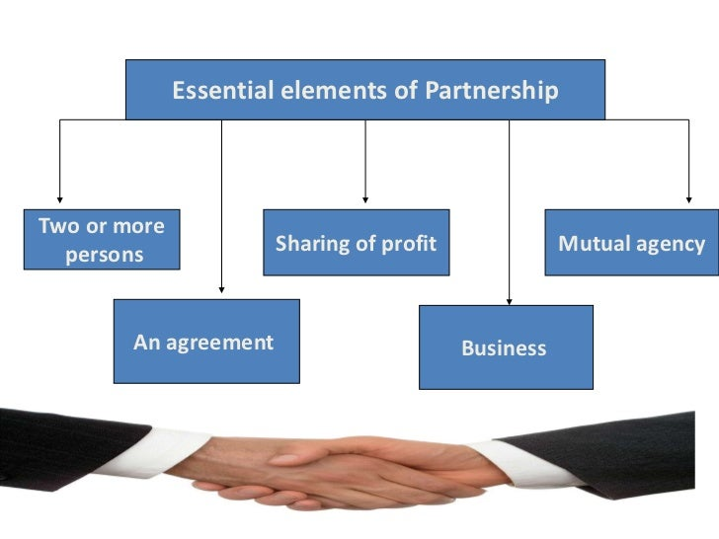
Partnership-Characteristics
Unlimited liability
Principal and agent relationship
Utmost good faith
Restriction on transfer of shares
Common management
Capital contribution
Protection of minority interests
Partners and partnership are one and the same.

Slide 17
Partnership – Advantages
Easy to form
Large Resources
Greater managerial talent
More credit standing more finance security
Promptness in decision making meet frequently
Sharing of risk
Secrecy (need not publish accounts)
Protection of minority interest
Easy Dissolution
Democratic administration
Saving in managerial expenses

Slide 18
Partnership – Disadvantages
Unlimited Liability
Limited resources
Instability - lack of trust, Insolvency and death
Mutual distrust, lack of confidence in each other
Limitations on transfer of shares
Burden of Implied Authority
Lack of public faith
Lack of prompt decisions
Cautious approach unlimited liability risk bearing capacity is limited

Slide 19
Kinds of Partners
Active Partners – working partner, Manger, Organiser, adviser and controller of all the affairs of the firm)
Sleeping or dormant partner
Secret Partner
Nominal partner
Partner in profits - Money and goodwill – behaviour and conduct
Partner by stopper or Estoppel or Partner by holding out

Slide 20
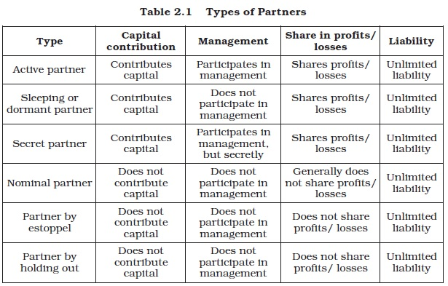

Slide 21
A minor is a person who has not attained the age of 18 years. Since a minor is not capable of entering into a valid agreement, he cannot become partner of a firm. He may, however, be admitted to the benefits of an existing partnership.
It is clear from the preceding discussion that partners can be of three categories:
(i) Those who share in the profits and losses of the business and assume liability of the business debts (like active partners, dormant partners and nominal partners).
(ii) Those who share in profits only (like minor partners) and
(iii) Those who assume liability without sharing in the profits of the business (like partners by holding out).

Slide 22
Formation and Registration Partnership Deed
The agreement entered into between partners may be either oral or written. When the agreement is in written form, it is called Partnership Deed. Partnership Deed lays down the terms and conditions of partnership and the rights, duties and obligations of partners. The following points are generally covered in the Deed:
The nature of business.
(ii) Name of the firm and the place where its business will be carried on.
(iii) Amount of capital to be contributed by each partner.
(iv) Duties, powers and obligations of all the partners.
(v) Method of preparing accounts and arrangement for audit.

Slide 23
(vi) Whether loans will be accepted from a partner over and above the capital also, if so, at what rate of interest.
(vii) The amount to be allowed as private drawings by each partner and the interest to be charged thereon.
(viii) The ratio in which profits are to be shared.
ix) Whether a partner can be expelled and, if so, the procedure for the same.
(x) Method for the settlement of disputes.
(xi) Circumstances under which the partnership will stand dissolved, and in case of dissolution, under whose custody the books of accounts will remain.
The Deed has to be stamped and each partner should have a copy of it.

Slide 24
Registration of Partnership Firm
Registration of a partnership firm is not compulsory under Indian Partnership Act. In England registration is compulsory. In India, certain privileges which are allowed to those firms, which are registered. But an unregistered firm suffers from certain disabilities. These disabilities make it virtually compulsory for a firm to get registered. A partnership firm may be registered at any time. That is, at the time of formation or at any time during its existence. A partnership firm desiring registration applies to the Registrar of Firms in prescribed form along with the registration fee. The application should state the following:
(i) Name of the firm.
(ii) The principal place of business of the firm.
(iii) The name of any other place where the firm is to carry on business
(iv) Date of admission of the partners in the firm.
(v) Names and permanent addresses of the partners.
(vi) Duration of the firm.
The application shall be signed and verified by each partner. Changes in the above particulars have to be communicated to the Registrar. The Certificate of registration is reliable evidence and a conclusive proof of the existence of the firm.

Slide 25
Consequences of Non-Registration
An unregistered firm suffers from the following serious disabilities:
(i) A partner of an unregistered firm can not file a suit against the firm or any other partner for enforcing his right arising out of the contract;
(ii) An unregistered firm cannot file suit against any third party for the recovery of the claims;
(iii) Such a firm also cannot file a suit against any partner.

Slide 26
Rights of Partners
Right to take part in the conduct of business
Right to express opinion
Right of access to accounts
Right to share in profits
Interest on capital
Right to interest on additional capital or loan
Right to indemnity(compensate)
Right in the firm’s property
Right to leave the firm
Right not to be expelled
Right to do competitive business
Right to share in profits after retirement

Slide 27
Duties of a Partner
Should act diligently and honestly in the discharge of his duties to the maximum advantage of all the partners.
Should act in a just and faithful manner towards other partner and partners.
Should bound to share to losses of the firm equally unless and otherwise agreed upon by all partners.
Should indemnify(compensate) the firm against losses sustained due to his wilful negligence in the business.
Maintain true and correct accounts relating to the firm
No partner should make secret profits by way of commission or otherwise from the firm’s business.
No partner is allowed to assign or transfer his rights and interest in the firm to an outsider without the consent of other partners.

Slide 28
Types of Partnership
Partnerships can be classified on the basis of two factors, viz.,
duration and liability.
On the basis of duration
Partnership at will
Particular partnership
On the basis of liability
with limited liability
with unlimited liability

Slide 29
General Partnership
the general partnership definition can be stated as those partnerships where rights and responsibilities are shared equally in terms of management and decision making. Each partner should take full responsibility for the debts and liability incurred by the other partner. If one partner is sued, all the other partners are considered accountable. The creditor or court will hold the partner’s personal assets. Therefore, most of the partners do not opt for this partnership.
PARTICULAR Partnership
Is a partnership formed for a single transaction and it would last as long as the business is not completed.
Ex: Construction Business

Slide 30
Partnership at Will
Partnership at Will can be defined as when there is no clause mentioned about the expiration of a partnership firm. Under section 7 of the Indian Partnership Act 1932, the two conditions are:
The partnership agreement should have not any fixed expiration date.
No particular determination of the partnership should be mentioned.
Therefore, if the duration and determination are mentioned in the agreement, then it is not a partnership at will. Also, initially, if the firm had a fixed expiration date, but the operation of the firm continues beyond the mentioned date that it will be considered as a partnership at will.

Slide 31
Limited Liability Partnership(LLP)
A limited liability partnership is a partnership consisting of partners whose liability is limited to the capital invested by each for starting the business. In a LLP, your personal property is not liable for the firm’s debts. Moreover, an LLP is a corporate body having a legal entity independent of the partners who are a part of the organization.
The Limited Liability Partnership (LLP) integrates the ease of running a Partnership along with the separate legal entity status and limited liability aspects of a company. Such an entity has minimal compliance requirements and need not conduct an external audit of its books until it has a turnover of Rs. 40 lakh per year or a paid-up capital contribution of Rs. 25 lakh.

Slide 32




Limited Liability Partnership
^{Origin}
The Limited Liability Partnership was formed in the early 1990s in United States in the consequence of the collapse of real estate and energy prices in Texas in the 1980s.
Apart from India Many Countries like Canada, China Germany, Greece, Japan, Kazakhstan, Poland, Romania, and Singapore have felt the need to recognize LLPs in their country.
^{In India}
The Limited Liability Partnership Act, 2008 was published in the official Gazette of India on January 9, 2009 and has been notified with effect from 31 March 2009.
The first LLP was incorporated in the first week of April 2009.

Slide 33
Limited Liability Partnership - Features
An LLP is a body corporate and legal entity separate from its partners.
It has perpetual succession (Continuous existence).
Has separate legislation (i.e. LLP Act, 2008),
Every Limited Liability Partnership shall use the words “Limited Liability Partnership” or its acronym “LLP” as the last words of its name.
It contains elements of both ‘a corporate structure’ as well as ‘a partnership firm structure’.
Every LLP shall have at least two designated partners being individuals, at least one of them being resident in India and all the partners shall be the agent of the Limited Liability Partnership but not of other partners.
LLP agreement is not mandatory but in the absence of LLP agreement, mutual rights and liabilities of partners shall be determined as provided under Schedule I to the LLP Act.

Slide 34
Limited Liability Partnership - Advantages
Is organized and operates on the basis of an agreement.
Liability of partners is limited to their agreed contribution in the LLP
Has more flexibility and lesser compliance requirements as compared to a company.
Simple registration procedure, no requirement of minimum capital, no restrictions on maximum limit of partners.
Easy to become a partner or leave the LLP or otherwise.
Is easy to transfer the ownership in accordance with the terms of the LLP Agreement.
As a juristic legal person, an LLP can sue in its name and be sued by others.
No restriction on limit of the remuneration to be paid to the partners like companies, but the remuneration must be authorized by the LLP agreement, and it cannot exceed the limit prescribed under the agreement.
The Act also provides for conversion of existing partnership firm, private limited Company and unlisted public Company into an LLP by registering the same with the Registrar of Companies (ROC).

Slide 35
Limited Liability Partnership - Disadvantages
^{Implied Authority}
Under some cases, liability may extend to personal assets of the partners.
Not allowed to raise money from Public.
Is required to comply with various rules & regulations and legal formalities.
It is very difficult to wind up the business in case of exigency as there are a lot of legal compliances under Limited Liability Partnership (Winding Up and Dissolution) Rules
Is very lengthy and expensive procedure.

Slide 36
Salient features of LLP as per LLP Act, 2008
i. LLP forms of organizations are governed by the Limited Liabilities Partnership Act, 2008 and The Indian Partnership Act, 1932 is not applicable to LLPs.
ii. LLP is a body corporate and as a result has legal entity separate from that of its partners.
iii. LLP has perpetual succession. In other words, LLP’s existence is not affected by death, bankruptcy, insanity and change in membership.
iv. Unlike shareholders of company, partners of LLP can directly manage the affairs of business. In other words, in case of LLP there is no separation between management and ownership.
v. The liability of LLP is to the extent of its assets. The partners are liable to the extent of the amount they have agreed to contribute to the LLP.

Slide 37
Salient features of LLP as per LLP Act, 2008
vi. A partner cannot be held responsible for the misconduct or negligence of other partners.
vii. The minimum number of partners is 2 and there is no maximum limit.
viii. There shall have at least two designated partners who are individuals and at least one of them shall be a resident in India.
ix. A private or unlisted public company and firm can be converted into LLP.
x. The winding up of LLP is either voluntary or by the High Court.

Slide 38
Limited Liability Partnership(LLP) Advantages
Legal Status of Entity
Member(s) Liability
Annual Statutory Meeting
Flexibility
Decentralization
Level of members
Tax advantage

Slide 39
Limited Liability Partnership(LLP) Disadvantages
Inclusion of Indian citizen as a partner
Transfer of ownership
Filing of various returns
Number of partners(Designated and Non-designated partners)
Non-recognition
Huge penalties
LLP form of organization is limited to only certain types of profession, such as, lawyers, accountants and architects.

Slide 40
Difference between LLP and Partnership
1. LLP is governed by the Limited Liabilities Partnership Act, 2008 whereas; partnership is governed by the Indian Partnership Act of 1932.
2. LLP is a type of partnership formed and registered according to the Limited Liabilities Partnership Act, 2008 whereas; partnership is a type of business organization where partners have agreed to carry on a business and share profit and loss of the business in accordance with the terms of the partnership agreement.
3. Partnership does not have separate legal entity, whereas; LLP has separate legal entity.
4. Registration is optional for partnership form of business, whereas; LLP must be registered as per LLP Act, 2008.
5. Partnership does not have perpetual succession, whereas; LLP has perpetual succession.

Slide 41
6. Liabilities of partners in case of partnership firm are unlimited, whereas; in case of LLP liabilities of partners are limited to the extent of contribution of partners, except in case of fraud.
7. Audit of accounts is mandatory for LLP only if turnover and capital contribution exceed Rs.40 lakhs and 25 lakhs respectively, whereas; for partnership audit is not mandatory.
8. Annual return filing is necessary in case of LLP, but partnership does not require submitting annual return.
9. The existence and operation of LLP are not affected by any change in partnership, whereas; annual return filing is not necessary in case of partnership

Slide 42
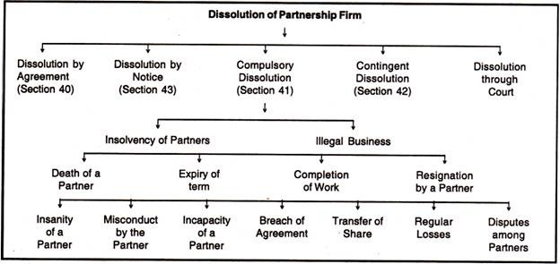

Slide 43
Dissolution of Partnership Firm
Dissolution by agreement: A partnership firm may be dissolved with the mutual consent of all the partners or in accordance with the terms of the agreement.
Dissolution by notice: In case of partnership at will, a firm may be dissolved if any partner gives a notice in writing to other partners indicating his intention to dissolve the firm.
Contingent dissolution : A firm may be dissolved on the expiry of the term, completion of the venture, death of a partner, adjudication of a partner as insolvent.
Compulsory dissolution: A firm stands automatically dissolved if all partners or all but one partner are declared insolvent, or business unlawful.
Dissolution through court: Court ma order the dissolution of a firm, when any partner becomes members unsound, permanently incapable of performing his duties, guilty of misconduct ,willfully commits breach of the partnership agreement, unauthorized transfers the whole of his interest or shar in the firm to a third person

Slide 44
Joint Hindu Family Business - Hindu Law
Undivided Hindu Family composite family- which is having an origin to an agreement
When two or more families agree to live and work together, through their resources and labour with joint stock and share profits and the losses together, then this family is known as composite family.
All the affairs of the joint Hindu family are controlled and managed by one person who is Karta or Manager. The Liability of Karta is unlimited but other members is limited.
Kartas’s powers are almost unlimited.
On the basis of the schools of Hindu law, joint Hindu family is considered under two heads:
Mitakshara – All over the country Except west Bengal and Assam
Dhayabhaga – only in west Bengal and Assam
Hindu Succession act 1956 even females have been included in the list of persons who acquire share in succession.

Slide 45
Hindu Undivided Family - Features
Governed by Hindu Law – uncodified or codified Hindu law –Mitakshara, Dhayabhaga
Membership by birth is acquired
Management- karta
Limited liabilities of others – joint family property which is liable for satisfying debts – self acquired property
Continuity-continues for ever, there is no limit to its membership number also
Minor also a member person from its very birth becomes the member
Accounts
Implied authority of karta

Slide 46
Joint Hindu Family - Advantages
Centralised management
Utmost secrecy
Quick decision
Credit facilities
Work according to capacity – physically handicapped or party disabled
Natural love between members
Economy
limited liability

Slide 47
Joint Hindu Family - Disadvantages
No reward for efficiency
Limited capital
Limited managerial skill
Suspicion

Slide 48
Co-operative Organisation
The cooperative movement has been necessitated to protect their interest of weaker sections of the society “Self help through mutual help”
Philosophy-“all for each and each for all” The Indian cooperative societies Act,1912 defines Co-operatives in section 4 as ‘a society which has its objectives the promotion of economic interest of its members in accordance with co-operative principle”

Slide 49
Co-operative Organisation - CHARECTERISTIC
Voluntary membership
Political and religious neutrality(neural as far as political and religious affiliations are concerned)
Democratic management (one man-one vote) (stands or falls with democracy)
One man one vote (cannot control strength of his wealth)
Service motive (profit is earned when goods are sold to non-members)
Distribution of surplus
Cash trading (flourish)
Limited interest on investments (9% dividend)
State control (incentives)
Co-operative education and training

Slide 50
Types of Cooperatives
Consumers Co-operatives
Producers Co-operatives
Marketing Co-operatives
Housing Co-operatives
Credit Co-operatives (Rural and urban)
Co-operative farming societies (large scale farming on scientific lives)

Slide 51
Cooperatives - Advantages
Open membership
Service motto
Supply of goods at cheaper rates
Democratic management
Low management cost
Surpluses shared by members
Check on other business (consumers are not on the mercy of businessman)
Limited liability
Zero speculation
Low taxation

Slide 52
Cooperatives - Limitations
Lack of capital
Lack of unity among members
(different sections of the society)
Cash trading
Political interference
(adversely affected cooperative movement in India)

Slide 53
Joint Stock Company
According to Companies Act, 2013 (Act No. 18 of 2013), a “company” means a company incorporated under this Act or under any previous company law [Section 2(20)].
According to Lord Justice Lindley, defines a company as “ an association of many persons who contribute money or money’s worth to common stock and employ it in some trade or business and who share the profit and loss arising therefrom. The common stock so contributed is denoted in money and is the capital of the company".

Slide 54
Joint Stock Company
JSC was started first in Italy in the 13th century
During 17th and 18th centuries, JSC were formed in England under the Royal Charter or acts of parliament.
In India the first companies act was passed in 1850 and the principle of limited liability was introduced only in 1857. The application of this act was extended to banking and insurance companies in 1860. A comprehensive bill was passed in 1956.
The firms incorporated under this act are known as companies. The parliament and state legislatures can also pass legislations for the incorporation of companies, generally called corporations.

Slide 55
Joint Stock Company- Characteristics
Association of person(S)-
Limited Liability
Independent Legal Entity
Common Seal
Transferability of Shares
Separation of Ownership and Management
Perpetual Existence
Corporate Finance
Centralized and Delegated Management
Publication of Accounts
The name of the company end with Ltd

Slide 56
Merits of Joint Stock Company
Accumulation of Large resources
Limited liability
Continuity of existence separate legal entity perpetual succession beneficial for the society wastage of resources and inconvenience to the customers
Efficient management
Ownership is separate from management attracts talented persons expand and diversify its activities
Economies of large scale production

Slide 57
Merits of Joint Stock Company
Transferability of shares
Diffused risk
Large no of persons
Democratic set up ownership and management
Social benefits mobilises scattered savings of the community, utilisation of natural resources, financial institutions
Ability to cope with technology changing business environment
Research and development

Slide 58
Demerits of Joint Stock Company
Difficulty in formation
Number of stages, legal formalities, expensive and risky
Separation of ownership and Management no stake in the company, board of directors are paid only commission.
Evils of factory system like large scale production, poor sanitation, air pollution, congestion of cities, monopolistic control
Speculation in shares – fluctuate in the prices
Fraudulent management
Lack of secrecy
Delay in decision making
Concentration of economic power – directors in number of companies
Excessive state regulation
High taxes

Slide 59
On Basis of Size of Company
Small Company
Other Company
On Basis of Number of Members
One Person Company
Private Limited Company
Public Limited Company
On Basis of Control
Holding Company
Subsidiary Company
Associate Company
On the Basis of Liability
Liability Limited by Shares
Liability Limited by Gurantee
Unlimited Liability
On the basis of Manner of Access to Capital
Listed Company
Unlisted Company
On the Basis of Nationality/ Domicile
Indian Company
Foreign Company
On the Basis of Incorporation
Statutory Company
Registered Company
Other Types of Companies
Section 8 Company
Government Company
Producer Company
Dormant Company
Nidhi Company
Chartered Company
Joint Stock Company- Types

Slide 60
Kinds of Companies
According to Incorporation
Chartered companies - This type of companies are incorporated under royal charter issued by the king or head of the state.
Certain exclusive rights and privileges are granted
If the company violates the rules, the head of the state can close such companies
Popular in England in 19th century
East India company, chartered bank of India or Australia.
These companies are no longer formed in any country.
2. Statutory companies - These companies are formed under a special act of parliament or of a state legislature. The objective powers and responsibilities of these companies are clearly defined in the act.
Companies for public utility services are formed and or special statutes–
Companies may or may not use the word limited
Companies are given wide powers under the act
RBI,IFCI,STC(state trading corporation),IDBI etc.

Slide 61
Registered Companies
Companies are formed and registered under the provisions of the Companies Act.
These method of formation management and liquidation are given under various clauses of this act.
These companies may be limited by Shares - Have a share capital
Capital is divided into shares
Shareholders pay share money at one time or by instalments
The shareholders are not liable to pay anything more than the value of the shares held by them, whatever be the liabilities of the company.
Ex:Wipro,Infosys

Slide 62
According to Liability
Companies Limited by guarantee
Companies are formed under the companies act with a stipulation in the memorandum clause that members are guaranteed to pay a certain amount of money in case of its winding up.
The amount which members undertake to pay is called the guaranteed money
Members buy shares of fixed value guarantee sum liquidation
Company Limited by Shares
The ownership of a company limited by shares includes the members of the general public. Any person from the public can own a share in the company by buying through the stock exchange. The liability of the shareholders of the company is limited to the nominal value of the shares.
Unlimited Liability companies
The companies registered without limiting the liability of members to the value of shares are called unlimited companies.
Companies are just like partnership concerns.
All the members will be liable to meet the liabilities of the company to an unlimited extent

Slide 63
On the basis of ownership
Government companies – or Public Sector Companies
Government Company is a company or an organization in which at least 51% of the paid up share capital is held by the central government or the state government or partly by both central and State Govt.
These are many government companies, few of them are, Steel Authority of India Limited, Bharat Heavy Electricals Limited, Coal India Limited, State Trading Corporation of India, etc.
Most of the companies in India are registered under the Indian Companies Act, 1956

Slide 64
On the Basis of Control
Holding Companies
A holding company is a parent company, limited liability company, or limited partnership that holds ample voting shares in another company.
The holding company can control the policies of its subsidiary company and oversee its management decisions.
Common examples of holding companies are conglomerates.
Subsidiary companies
A subsidiary is a company that belongs to another company, referred to as the parent company or holding company.
A subsidiary is an independent company that is more than 50% owned by another firm.
An example of a subsidiary is Google, owned by Alphabet; Instagram, owned by Facebook, and NBC, owned by General Electric.

Slide 65
Associate Company
This concept of associate company is new and has been introduced by Companies Act 2013.
is a firm that is owned in part by a parent company entity. Unlike a subsidiary company, the parent will only own a minority or non-controlling stake in the associate company.
An associate company is one in which that other company has significant influence, but which is not a subsidiary company of that other company. Significant influence means control of atleast 20% of total voting power or of business decisions under an agreement
A joint venture company will be an associate company
Mahindra and Mahindra Limited has Tech Mahindra Ltd. as its Associate Company with 26.04% holding

Slide 66
Small Company
A small company is new class of private limited company (introduced for the first time in Companies Act 2013 via sec.2(85) ) whose paid up share capital does not exceed 50 lakhs or turnover as per P&L account of the preceding financial year, does not exceed 2 crores.
However a Holding or a Subsidiary company, a Licensed company or a company governed by any Special Act will not be regarded as Small Company even if its capital or turnover is less than or equal to prescribed limits

Slide 67
Small Company
These companies enjoy additional exemptions and privileges in addition to those enjoyed by private companies. Eg. their financial statements may not include cash flow statement, they may hold just 2 board meetings in a year compared to at least 4 board meetings per year for other companies, exemption from mandatory rotation of auditors etc.
The Central Government is empowered to notify those sections of the Companies Act which shall not apply to Small Companies or shall apply with modifications, adaptations or exceptions

Slide 68
According to Nationality
Indian Companies -
A company incorporated in India under the Indian Companies Act, 1956
Whether operating in India or outside is called an Indian company.
There may be companies incorporated under act but separate rules are framed for their regulations
Ex:- Manufacturing, insurance, banking etc
Foreign companies –
"Foreign Company is defined under Section 2 (42) of the Companies Act, 2013 (the Act) as any company or body corporate incorporated outside India which (a) has a place of business in India by itself or through an agent, physically or thorough electronic mode and (b) conducts any business activity in India in any other manner,"

Slide 69
According to Transferability of shares
Private companies at least 2 – Max 50
Family affair
Transfer of share is restricted
Cannot issue prospectus
Private company may be limited by guarantee
There cannot be a private company with unlimited liability
Public companies- Sec 3(1) of the Indian companies act,1956 other than private companies are called public companies
at least 7 – Max unlimited
Transfer of share is allowed
Can issue Prospectus

Slide 70
One Person Company(OPC) - Sec. 2(62)
As per provision of section 2(62) of the Companies Act, 2013 defined “one person company” means a company which has only one person as member. Any natural person (should not be Minor) who is an Indian citizen whether a resident in India or not i.e. NRI shall be eligible to incorporate a One Person Company and appoint nominee of an OPC, Timeline for Non-Resident individuals has been reduced to 120 days. Necessary to mention the words 'One Person Company" in brackets below the company's name wherever printed/engraved/affixed
Such company enjoys certain additional exemptions like-
Number of directors can range from 1 - 15
No need of their rotational retirement
No compulsion to conduct board meetings if there is just 1 director
No need to hold AGM/ EGM
The Financial Statements may not include cash flow statement and may be signed by just 1 director
BOD report is not too detailed, Annual Return can be abridged
Financial statements can be filed with ROC within 180 days of closure of financial year etc.

Slide 71
One Person Company(OPC)
Always incorporated as a private company.
It may be limited by shares or limited by guarantee or an unlimited company
This OPC status and concessions will be withdrawn if it's paid up share capital exceeds 50 lakhs or average annual turnover during preceding three consecutive financial years exceeds 2 crores.
In such a case, the OPC is required to convert itself within next 6 months, into a private or a public Co and take necessary steps such as - alteration of its AoA and MoA for making changes incidental to conversion, give notice to ROC(within a period of 60 days of conversion) informing it of cessation of its OPC status and conversion into private or public company as the case may be.

Slide 72
OPC Advantages
It has separate legal entity.
The liability of shareholder/ director is limited
The organized version of OPC will open the avenues for more favorable banking facilities
Legal status and social recognition for your business.
It gives suppliers and customers a sense of confidence in business.
The director and shareholder can be same person
On the death/disability company can be succeed by nominee.
Exemption available from various provisions under Company law.

Slide 73
Sec.8 Company
These companies are meant for promoting science, art, commerce, sports, religion, charity, social welfare, environmental protection or other useful objects. Eg. National Sports Club of India etc.
Before registration under Company's Act, they have to apply to the Central Govt. for a license which shall be granted on prescribed terms and conditions (this licence can be revoked by CG anytime this company contravenes any prescribed term\ condition)
These companies are required to apply its income for promoting its objects and are not allowed to pay any dividends to its members. Even on winding up ,if any surplus assets are left after paying off all the debts and liabilities, those surplus assets will either be transferred to another Licensed company having similar objects or may be sold and proceeds shall be credited to Insolvency and Bankruptcy Fund.

Slide 74
Sec.8 Company
These companies have limited liability but are exempted from using words 'limited' or 'private 'limited' with their name.
These companies are subject to certain exemptions in form of tax benefits, procuring land and immovable at concessional rates, permission to receive donations etc. Further certain notified Sections of the Companies Act,2013 do not apply to such companies or apply but with some exceptions, modifications and adaptations.

Slide 75
Dormant Company
The Companies Act ,2013 introduced for the first time , the concept of dormant company by virtue of Sec.455. This concept is relevant where a company is not presently active because say, promoters have incorporated a company but there is either a dispute among them, or the ultimate project for which company was formed has failed through or company has been formed for holding some asset or IPR for some business activity to be undertaken in future. In such cases, by obtaining dormant status, the legal status of the company remains intact and the name is available to the company for future business programs and at the same time it has to comply with some minimum prescribed legal formalities.
A dormant company is one which is- formed and registered under this Act for a future project or to hold an asset or intellectual property and has no significant accounting transaction or -is an inactive company . An inactive company is that which, from the last two years, has not been carrying any business or operation or has not made significant accounting transaction or has not filed financial statements and annual returns.

Slide 76
Producer Company
Provisions governing Producer Companies are contained in Part IXA of Companies Act,1956 under sections 581A to 581ZT. Eg. Coconut Producer Company Limited, Madhya Bharat Consortium of Farmers Producer Co.Ltd.etc.
Producer Companies come into existence either by incorporation under the Companies Act as a private limited company or by conversion of existing Cooperatives into private limited companies on optional basis. These companies work on cooperative principles of mutual assistance, patronage and limited return and their names must end with words' Producer Company Limited'. These companies enable farmers and primary producers to formulate collective production and marketing strategies, negotiate better terms with buyers, buy inputs and fertilizers in bulk and receive technical guidance at their doorsteps. A producer company is a hybrid between a Cooperative Society and a Private Limited Company and thus enjoys advantages of limited company with minimal administrative control of the government.

Slide 77
Nidhi Company
As per Section 406, a company which has been incorporated as a Nidhi with the object of cultivating the habit of thrift (cost cutting) and savings amongst its members, receiving deposits from, and lending to, its members only, for their mutual benefits and which complies with such rules as are prescribed by the Central Government for regulation of such class of companies.

Slide 78
Formation of a Company
There are Four Stages in the formation of a company
1.Promotion
2.Incorporation
3.Subscription of Capital
4.Commencement of Business
However for a Private Limited Company only first two stages are applicable.

Slide 79
Stage 1.Promotion of a Company
“ Promotion may be defined a the discovery of business opportunities and the subsequent organisation of funds, property and managerial ability into a business concern for the purpose of making profits therefrom”
Stages of promotion
Discovery of an idea
Detailed investigation
Assembling the requirements
Financing proposition

Slide 80
Promotion of a Company
Section 2(69) of the Companies Act, 2013, defines promoters as an individual who:-
Is named as a promoter in the prospectus or in the annual returns of the company.
Controls the affairs of a company, directly or indirectly.
Advises, directs, or instructs the Board of Directors.
Promotion is considered as putting an idea into practice.
Promoter means
“ a person who originates the scheme of the promotion of a company has the memorandum and articles prepared executed and registered and find the first directors settles the terms preliminary contracts and prospectus if any and makes arrangements for advertising and circulating the prospectus and raising the capital”.
“A promoter is the person conscious of the possibility of transforming an idea into a business capable of yielding a profit; who brings together various persons concerned and who finally, superintendents the various steps necessary to bring the new business into existence.” —Arthur Dewing

Slide 81
Promotion of a Company
Kinds of Promoters
Professional promoters England – Issue Houses, USA – Investment banks, Germany – Joint Stock Banks
Occasional promoters – Engineers, Lawyers etc
Financial promoters -Some financial institutions of financiers may take up the promotion of a company. They generally take up this work when financial environment is favourable at the time.
Managing agents as promoters:In India, Managing Agents played an important role in promoting new companies. These persons used to float new companies and then got their Managing Agency rights. Managing Agency system has since long been abolished in India.

Slide 82
Promotion of a Company
Promotional aspects maybe divided into two categories:
1. Procedural Aspects: Decisions relating to planning and organising a business(entrepreneurial decisions)
2. Legal aspects or legal formalities involved in promotion

Slide 83
Procedural Aspects of Promotion
Product Analysis
Marketing products
Financial planning
Size of business unit
Internal organisation
Location of the unit
Plant layout
Launching an enterprise

Slide 84
Legal Aspects of Promotion
Registration or Incorporation
Capital subscription
Commencement of business

Slide 85
Stage 2. Registration or Incorporation:
A Company being an artificial entity comes into existence only after its registration with the Registrar of Companies.
Steps for Incorporation:
Step1:Application for approval of name :
Emblems and names(prevention of improper use) Act-1950
Registrar is expected to approve the name-within 14 days of the receipt of the application.
The proposed name must be registered within 3 months from the date of intimation by the Registrar.

Slide 86
Procuring Digital Signature Certificate
Once the company name has been approved by Ministry of Corporate Affairs(MCA) and registered, the next step is procuring a Digital Signature Certificate for your private limited company.
Digital Signature Certificate is a form of a digital key, which holds all the vital information about the registered signatory like name, address, email, phone number, and the authority which has provided the certificate.
Digital Signature for a registered company enables the authorized signatory to prove its identity and sign documents electronically. For e-Filing, Digital Signature Certificate is a mandatory requirement.
Applying for Director Identification Number or DIN
Director Identification Number or DIN is the unique identification number for Directors of a registered company. Only once DIN is approved, the corporation documents can be filed under Registrar Form No.-DIR-3

Slide 87
Step 2: Preparation of Memorandum Of Association:
It is the constitution of the company which describes its objects and scope and the relation with outside world
Memorandum is to be signed by at least seven members in case of Public.Ltd.Co
And at least two persons in case of a Pvt.Ltd.Co
The memorandum should be properly stamped.
Step3: Preparation of Articles Of Association:
Document which contains rules and regulations relating to the internal management of the company
A Public limited company may not file its own Articles of Association ,it may adopt model clauses prescribed in table A Schedule I of the act.
A Private limited company is also required to submit its Articles duly signed by the signatories.

Slide 88
Step4:Preparation of other documents:
The promoters are also expected to prepare the following documents at the time of incorporation the company
The consent of directors is acquired and filed with the Registrar of Companies(ROC)
The promoters should execute a power of attorney in favor of one of them or an advocate who is to carry out the formalities required for registration
Copies of preliminary agreements, Memorandum and Articles of Association must also be prepared and filed at the time of registration.
Step 5: Payment of Fees
Step 6: A statutory declaration
The Registrar also allocates a Corporate Identity Number (CIN) to the company which is a distinct identity for the company. The allotment of CIN is on and from the company’s incorporation date. The certificate carries this date.

Slide 89
Stage 3:Capital Subscription:(To raise funds)
A public Limited company cannot commence business unless minimum subscription as stated in the Prospectus has been subscribed.
If the company does not receive 90% of the issue amount from the public subscription within 120 days from the date of opening of the issue , the amount should be refunded.(Companies Act 2013)
Issue of Share Capital : The shares are allotted after the close of the issue. If there is over subscription of the issue then allotment is done in consultation with Stock Exchange .
If applications are less (under subscription)then no allotment is made and all the money refunded within 10 days.

Slide 90
Stage 4:Commencement of Business
After raising minimum subscription, the company has to apply for Certificate of commencement with following details.
A)Minimum subscription as stated in the Prospectus is collected.
B)Directors have paid as much as called up on the shares held by them.
C) All Legal formalities are fulfilled to this effect , should be duly signed by any one of the directors ,legal solicitor or CA.

Slide 91
Company Formation
Main documents in a Company formation
Memorandum of Association
Articles of Association
Prospectus

Slide 92
Memorandum of Association
The Memorandum of Association is the constitution of the company and provides the foundation on which its structure is built.
It is the Principal document of the company and no company can be registered without the Memorandum Of Association. It defines the scope of the company activities as well as its relationship with investors and the outside world.
The Company should work within the framework of MOA. It is a public document and hence printed and made available at a price to the public.
Sec 2(8) of the Companies' Act defines a “Memorandum” as “ The memorandum of association of a company as originally framed or as altered from time to time in pursuance of any previous company laws or of this act” The contents of the memorandum are explained in section B of the Act.

Slide 93
Purpose of MOA
The main purpose of the Memorandum is to explain the scope of activities
of the company.
The Prospective shareholders know the areas where company will invest their money and the risk, they are taking in investing the money. The outsider’s will understand the limits of the working of the company and their dealing with it should remaining within the prescribed scope.
Clauses of Memorandum
The Name clause- A company may select any name which does not resemble the name of any other company and it should not contain the words like king, queen, emperor, govt bodies and the names of world bodies like UNO,WHO, IMF etc.
The name of the company must be painted outside every place where business of the company is carried on
The company name which is undesirable or resemble the name of any other existing company – Changed by – passing an ordinary resolution.

Slide 94
2. Registered office Clause : The place of registered office can be
intimated to the registrar within 30 days of Incorporation or
commencement of business, whichever is earlier.
A company can shift its registered office from one place to another.
Same town – intimation to the registrar.
one town to another – a special resolution is required to be passed.
One state to another state – alteration in the memorandum
3. Liability Clause : This clause states that the liability of the members is limited to the value of shares held by them.
4.Capital Clause – This clause states that total capital of the proposed company
Division of preference and equity share capital.

Slide 95
5. Objects Clause – one of the important clauses,
It determines the rights and powers of the company and defines its sphere of activities.
The Companies ( Amendment) Act, 1965 requires that in case of companies formed after this amendment, the memorandum must state separately (a) Main Objects (b) Other objects
Main Objects – will include objects to be pursued by the company on incorporation and objects incidental or ancillary to the attainment of the main objects.
Other objects will include all the objects which are not included in the main objects.

Slide 96
Articles of Association
The rules and regulations which are framed for the internal management of the company are set out in a document named Articles of Association. AOA help in achieving the objectives laid down in the memorandum.
Contents
The amount of share capital issued, different types of shares, calls in shares, forfeiture of shares, transfer of shares and rights and privileges of different categories of shareholders.
Power to alter as well as reduce share capital
The appointment of directors, powers, duties and their remuneration
The appointment of managers, managing director etc.
The procedures for holding and conduction of various meetings.
Matters relating to maintaining of accounts, declaration of dividends and keeping of reserves etc.
Procedure for winding up the company

Slide 97
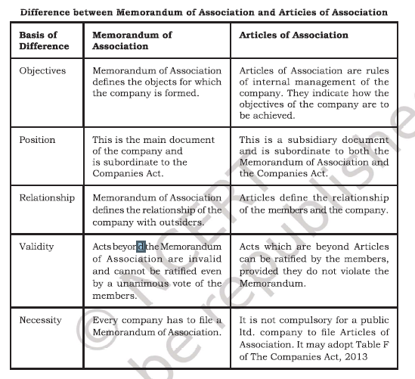

Slide 98
Prospectus - Statement in lieu of prospectus
Sec 2(36) “ A Prospectus means any document described or issued as prospectus
and includes any notice, circular, advertisement or other documents inviting deposits from public or inviting offers from the public for the subscription or purchases of any shares in or debentures of a body corporate.”
Contents
Name and full address of the company
Full particulars about the signatories to the memorandum of association and the number of shares taken up by them.
The number and classes of shares. The interest of shareholders in the property and profits of the company.
Names, address and occupations of members of the board of directors or proposed directors
The minimum subscription fixed by promoters
If the company acquires any property from vendors their full particulars are to be given.

Slide 99
The full address of underwriters if any and the opinion of directors
that the underwriters have sufficient resources to meet their obligations
The time of opening of the subscription list
The nature and extent of interest of every promoter in the promotion of the company
The amount payable on application allotment and calls
The particulars of preferential treatment given to any person for subscribing shares or debentures
The particulars about reserves and surpluses
The amount of preliminary expenses
The name and address of the auditor
Particulars regarding voting rights at the meetings the company
A report by the auditors regarding the profit and losses of the company.

